Slide 1
Multi-Modality Anomaly Detection and Classification Using Heterogenous Autoencoder with Multi-Scale Sparse Transformer
MEMBERS:
GLIFFY DORNICK E R 9517202109018
KARNAS SAGAR S 9517202109026
SAKTHI JEGANATHAN R 9517202109045
GUIDE:
Dr.E.EMERSON NITHIYARAJ
Assistant Professor, AI&DS
Department of Artificial Intelligence and Data Science
Mepco Schlenk Engineering College

Slide 2
Objective
To develop an anomaly detection system using medical images and a heterogeneous auto-encoder model
To optimize the computational performance by implementing a multi-scale sparse Transformer block
To develop an anomaly classification model using ensemble methods

Slide 3
Literature Survey
S.NO | Reference Paper | Advantages | Gap Limitations
1 | Encoder-Decoder Contrast for Unsupervised Anomaly Detection in Medical Images | EDC method addresses the challenge of obtaining labeled anomalous data, which is often scarce in medical contexts. | The integration of contrastive learning with feature reconstruction adds complexity to the model architecture and training process.
2 | Image Reconstruction for Accelerated MR Scan With Faster Fourier Convolutional Neural Networks | to capture long-range dependencies and mitigate artifacts in the reconstructed images, leading to higher quality outputs. | Their effectiveness may not directly translate to other imaging modalities or applications without further adaptation.

Slide 4
Literature Survey(Contd…)
S.NO | Reference Paper | Advantages | Gap Limitations
3 | Anomaly Detection for Medical Images Using Teacher–Student Model With Skip Connections and Multiscale Anomaly Consistency | enables the model to maintain important features across different scales, improving both detection and localization of anomalies. | The model may still face challenges related to data imbalance, particularly in scenarios where abnormal cases are rare,
4 | MTANet: Multi-Task Attention Network for Automatic Medical Image Segmentation and Classification | Combines segmentation and classification in one model, improving feature sharing and computational efficiency. | Needs further validation across diverse imaging modalities and clinical settings to ensure generalizability.

Slide 5
Literature Survey(Contd…)
S.NO | Reference Paper | Advantages | Gap Limitations
5 | Brain Tumor Classification Using an Ensemble of Deep Learning Techniques | Combines multiple models for accurate classification of brain tumors, High generalization capability, making it reliable on new datasets. | Requires substantial computational resources for training multiple deep learning models.
6 | A Deformable Constraint Transport Network for Optimal Aortic Segmentation From CT Images | Enhances clinical workflow efficiency by automating segmentation and quantitative measurement. | High computational complexity and memory requirements due to advanced network architecture.

Slide 6
Literature Survey(Contd…)
S.NO | Reference Paper | Advantages | Gap Limitations
7 | A Test Statistic Estimation-Based Approach for Establishing Self-Interpretable CNN-Based Binary Classifiers | Enhances trust and transparency in medical imaging decisions. Avoids ambiguity associated with post-hoc interpretability methods | Complex implementation requiring expertise in decision theory and deep learning. May require high-quality labeled data for accurate interpretation.
8 | CNX-B2: A Novel CNN-Transformer Approach For Chest X-Ray Medical Report Generation | Handles both normal and abnormal cases effectively using a new dataset and combines CNN's spatial feature extraction with Transformer's language generation strengths. | Implementation complexity requires expertise in CNN-Transformer architectures.

Slide 7
Modules in the Proposed Method
Modality Classifier
Anomaly Detection
Anomaly Classifier

Slide 8
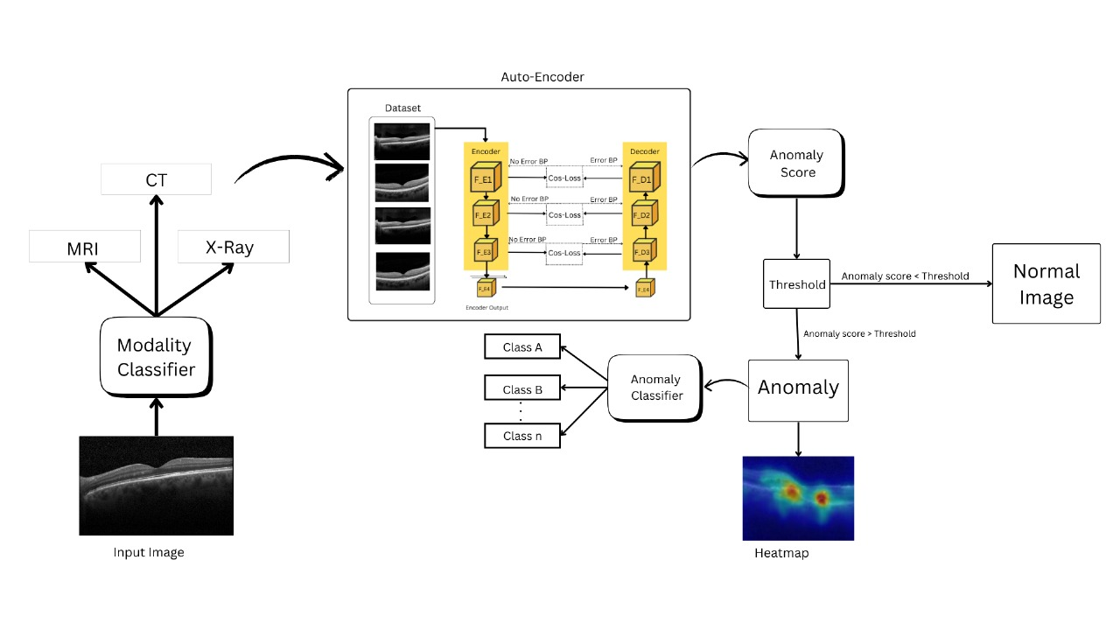
Proposed Work Flow

Slide 9
Datasets Used
Retinal OCT Dataset
it contains four categories, including choroidal neovascularization (CNV), diabetic macular edema (DME), Rrusen, and normal.
The training set contains 26,315 normal images. The test set contains 250 normal images and 750 abnormal images

Slide 10
Datasets
Chest X-Ray Dataset
The Chest X-ray dataset contains 5856 X-Ray images and two categories (Pneumo nia/Normal).
The training set has 5232 X-ray images, and the test set consists of 234 normal images and 390 pneumonia images.

Slide 11
Datasets
Brain MRI Dataset
The dataset contains 7022 images of human brain MRI with four categories: glioma, meningioma, pituitary, and no tumor

Slide 12
Datasets
COVID-19 Dataset
It contains three categories, including Covid-19, pneumonia, and normal
The training set and test set have 251 and 66 images

Slide 13
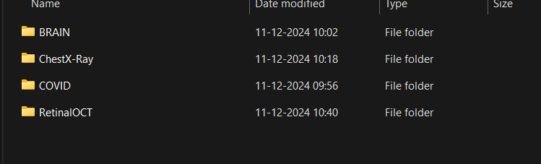
Dataset Collection

Slide 14
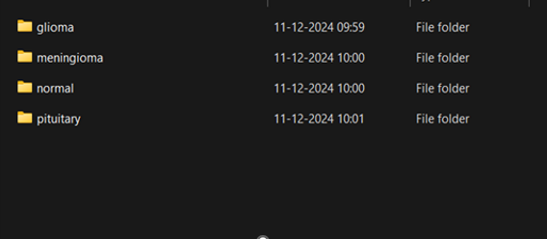
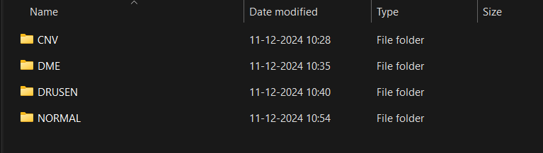
Brain MRI
Retinal OCT

Slide 15
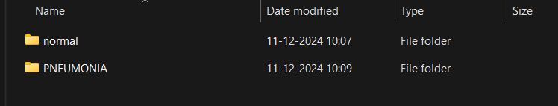
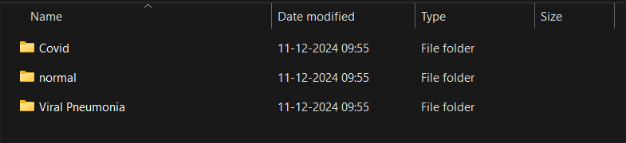
Chest x-ray
Covid

Slide 16
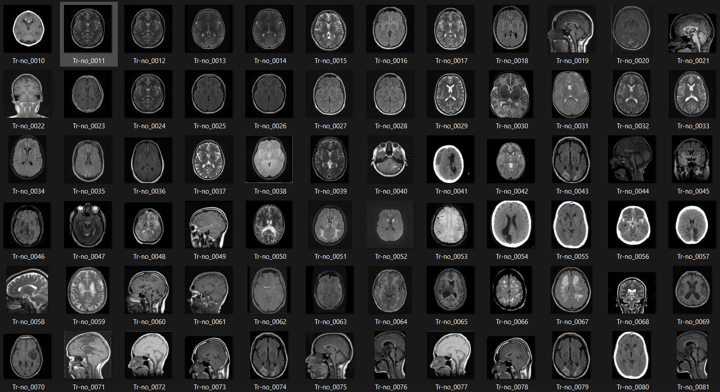
Brain

Slide 17
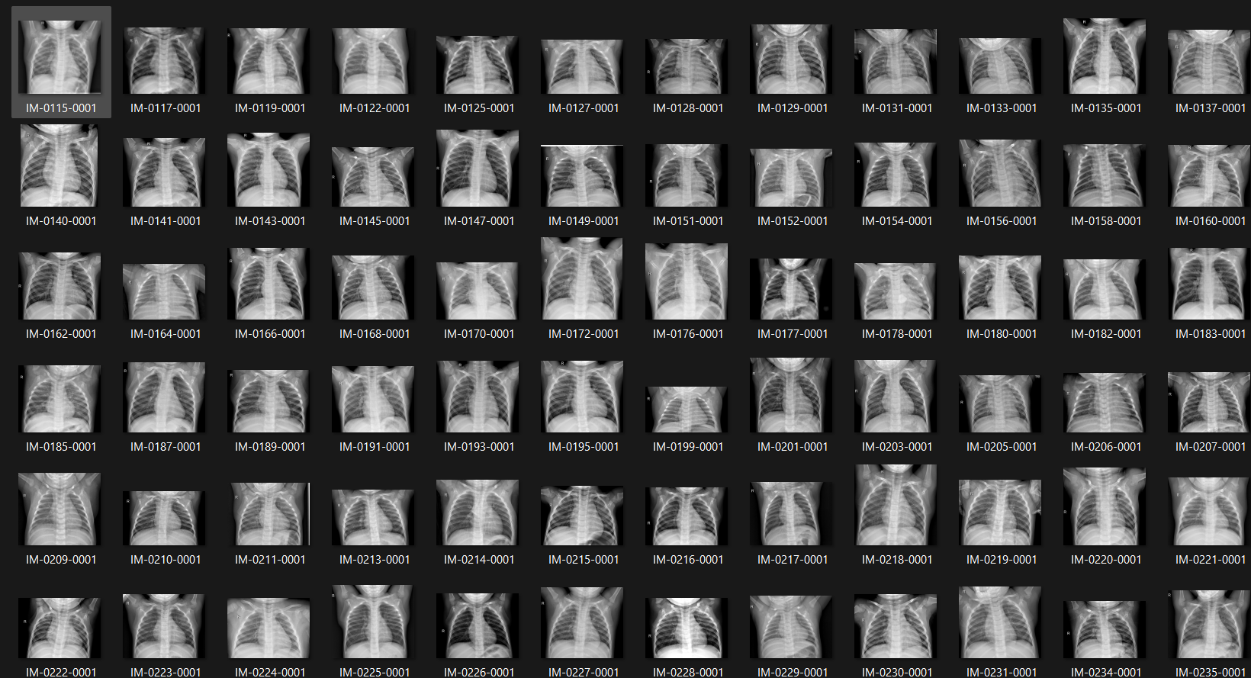
Chest X-Ray

Slide 18
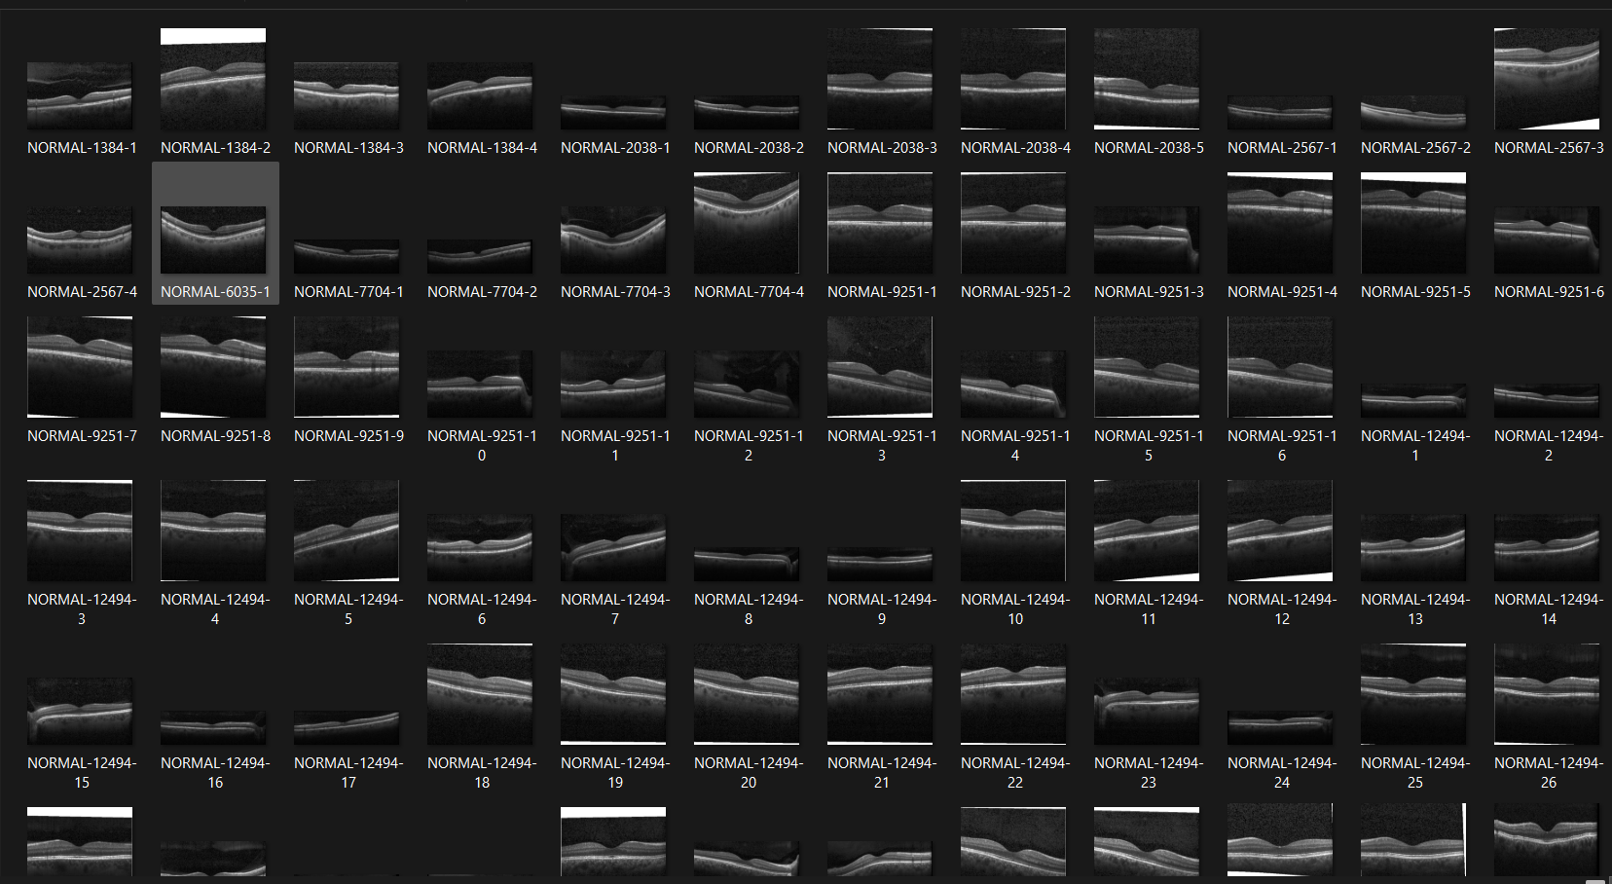
Retinal OCT

Slide 19
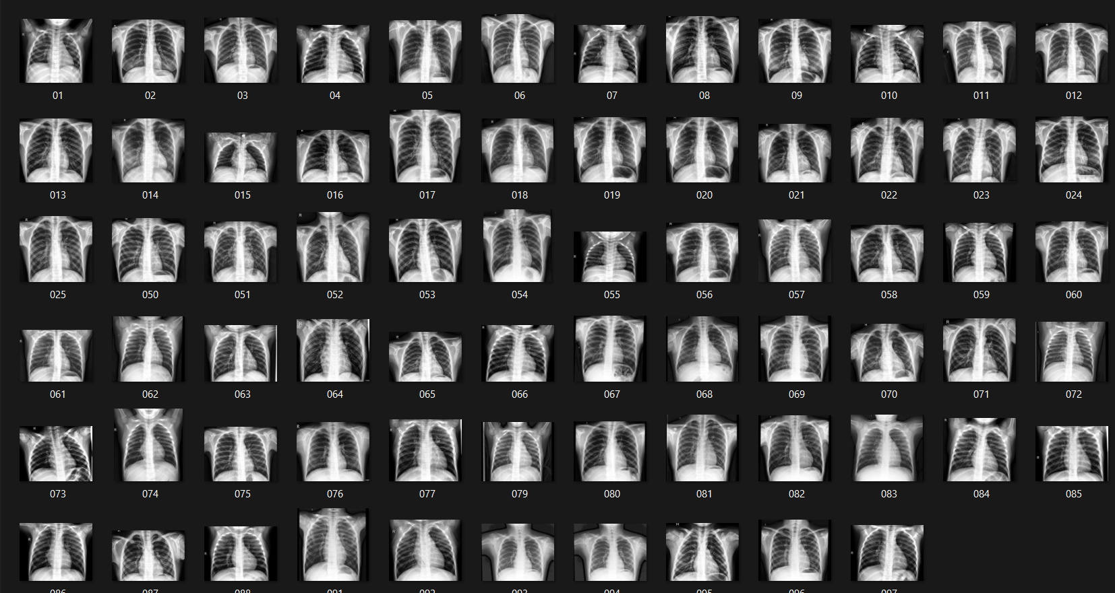
Covid

Slide 20
Module-1
Modality Classifier:
EfficientNet-B0 is a lightweight yet powerful deep learning model optimized for image classification.
It uses a compound scaling approach to balance depth, width, and resolution, making it highly efficient for medical image analysis.

Slide 21
Pre-trained Model | ACC (%) | Precision (%) | Recall (%) | F1-Score (%) | Specificity (%) | AUC (%)
EfficientNet-B0 | 100 | 100 | 100 | 100 | 100 | 100
InceptionV3 | 99 | 98.8 | 99.2 | 99 | 98.5 | 99
MobileNet | 98.5 | 98.2 | 98.7 | 98.4 | 97.8 | 98.6
GoogleNet | 94 | 93.5 | 94.2 | 93.8 | 93 | 94.5
VGG-16 | 93.5 | 93 | 93.8 | 93.4 | 92.5 | 93.7
Resnet-18 | 92 | 91.5 | 92.2 | 91.8 | 91 | 92.5

Slide 22
Module-2
Encoder
Decoder
Feature Comparison
Loss and Anomaly Score

Slide 23
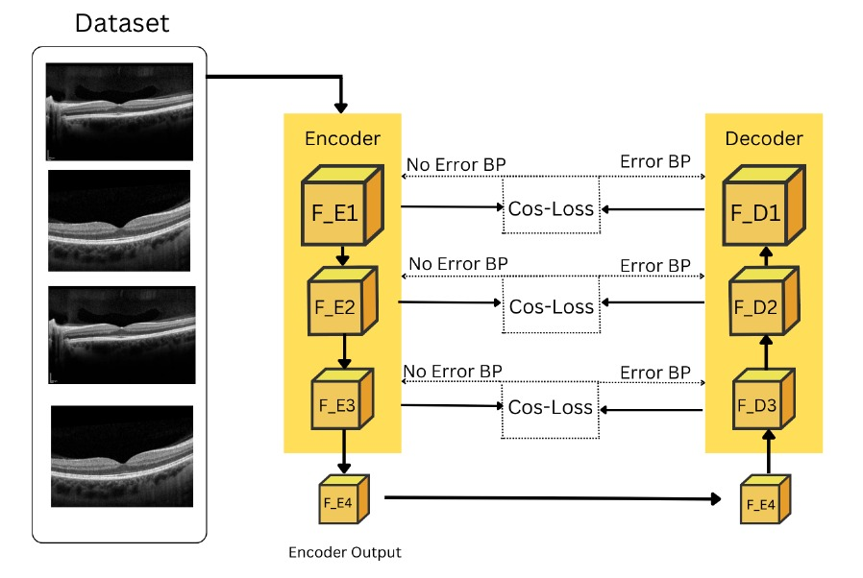
System Design

Slide 24
1. Encoder
Input Handling
The encoder takes medical images as input.
These images are usually in 2D format

Slide 25
Encoder ( Contd…)
CNN Backbone Selection
ResNet architecture is used as the CNN backbone.
To learn deep features without the problem of vanishing gradients

Slide 26
Encoder ( Contd…)
Layer Stages of the Encoder
The encoder structure consists of four stages
sequentially downsample the image and apply convolutions to extract higher-level features

Slide 27
Encoder ( Contd…)
Compressed Feature Maps
capture the most important features of the input image in a lower-dimensional space.
makes it easier for subsequent processing steps to analyze the image data efficiently.

Slide 28
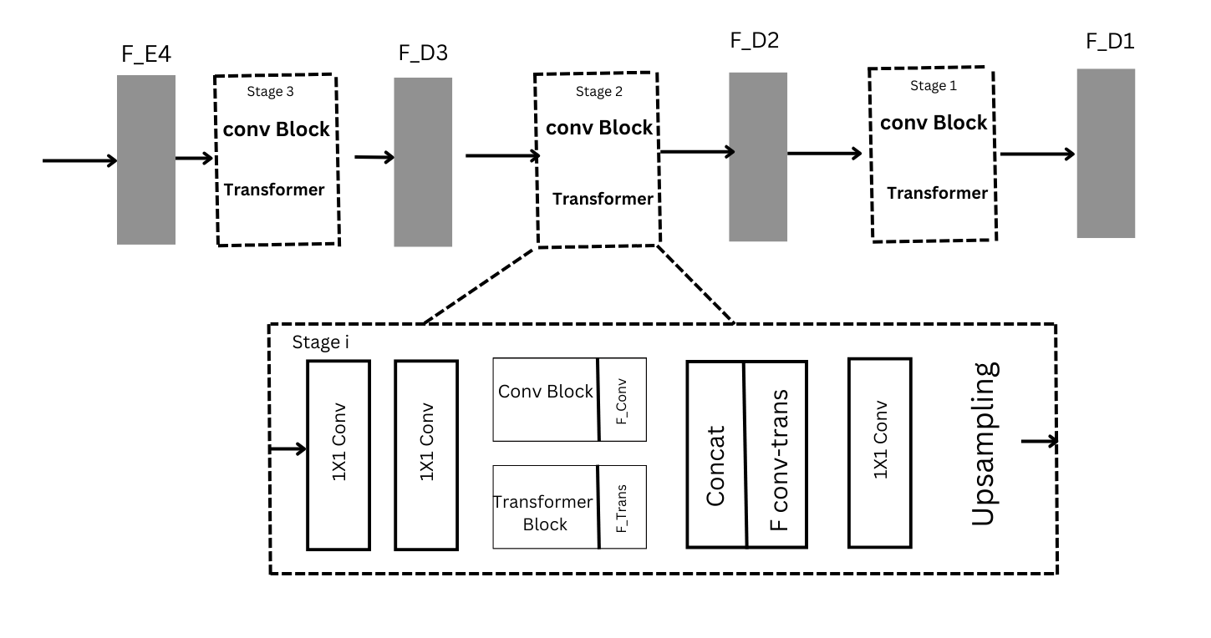
System Design ( Contd…)

Slide 29
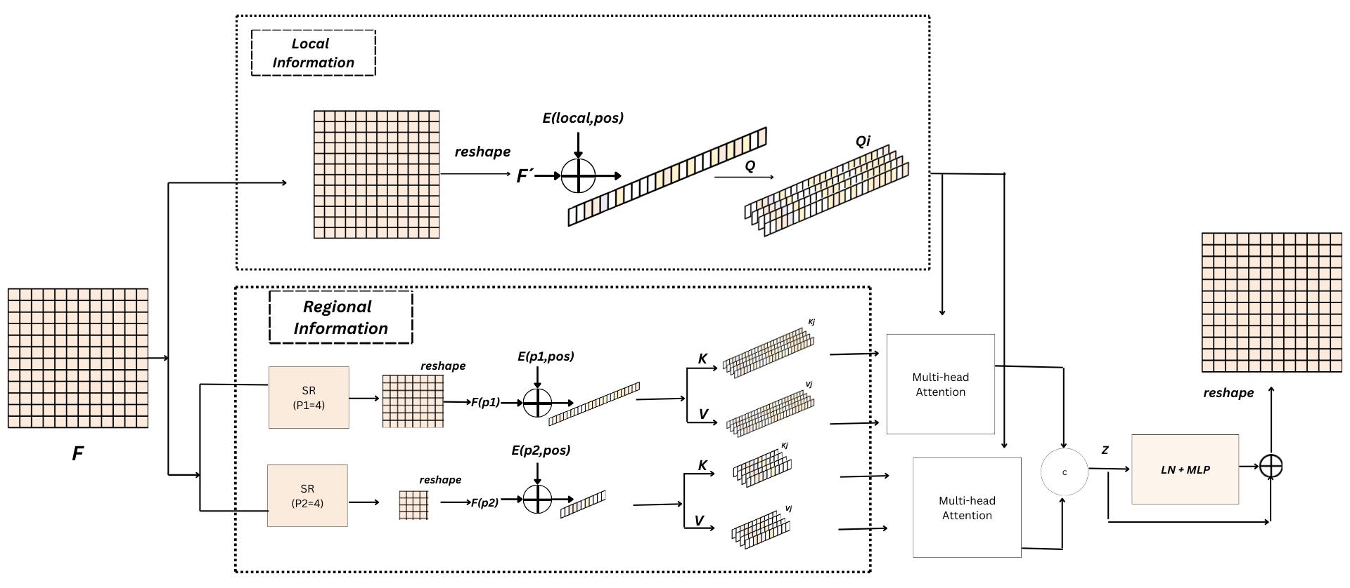
System Design ( Contd…)

Slide 30
2. Decoder
The decoder integrates both CNN and Transformers
CNN-local spatial features
Transfomers- long-range dependencies and global relationships

Slide 31
Decoder ( Contd…)
Hybrid CNN-Transformer
CNN block, learning and reconstructing fine-grained, local features from the compressed feature maps.
Transformer block, Processes larger-scale, long-range dependencies to better capture global patterns in the image.

Slide 32
Decoder ( Contd…)
CNN Block
Local features from the compressed feature maps.
It consists of two consecutive convolutions with a kernel size of 3×3 and a stride of 1×1.

Slide 33
Decoder ( Contd…)
Multi-Scale Sparse Transformer Block
Manages multi-scale feature extraction and balancing the computational complexity of the Transformer.
models both local and regional information
reduces the computational cost

Slide 34

$${ Q}_{j}= F_{\left\{local\right\}}^{p}W_{j}^{Q}, \\ { K}_{j}^{p}= F_{region}^{p}W_{j}^{K}, \\ { V}_{j}^{p}= F_{region}^{p}W_{j}^{V}$$
Qj- Local anomaly for a given parameter at location j
Kj- Regional anomaly for a given parameter at Vj- Another regional value or anomaly for a given Flocal- Local correction factor for parameter
Fregion- Regional correction factor for parameter p
W^Qj- Weight for location j related to the anomaly Q.
W^Kj- Weight for location j related to the anomaly K.
W^Vj- Weight for location j related to the value V.

Slide 35
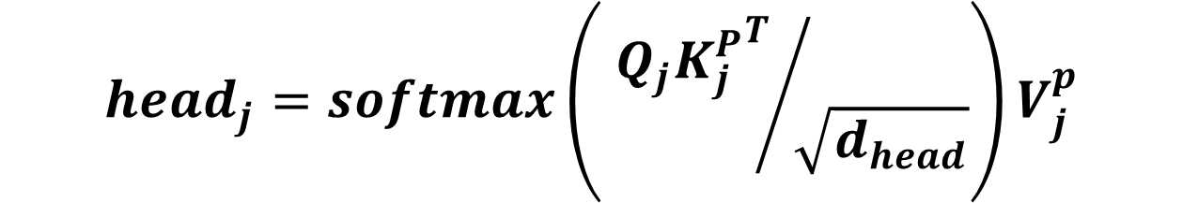
$$head_{j}=softmax\left.\left( {{Q_{j}K_{j}^{P}}^{T}}/{\sqrt{d_{head}}}\right.\right)V_{j}^{p}$$
Qj​: Query vector for location j, which represents the local features.
Kj: Key vector for location j and parameter p, representing the regional features.
Vj​: Value vector for location j and parameter p, which holds the contextual information.
dhead​: Dimensionality of the head, used for scaling to stabilize gradients.

Slide 36
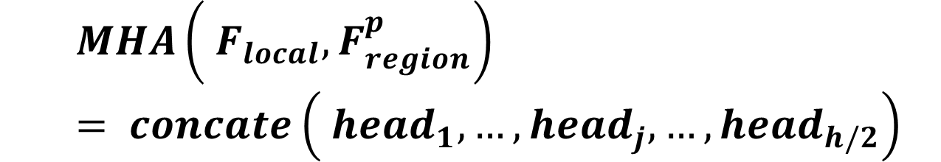
$$MHA\left.\left( F_{local}, F_{region}^{p}\right.\right)= concate\left.\left( {head}_{1}, …, {head}_{j}, …,{head}_{h/2}\right.\right)$$
MHA: Multi-Head Attention mechanism.
F_local​: Local feature map.
F_region​: Regional feature map for parameter p.
headj: Individual attention head for location jjj.

Slide 37
Decoder ( Contd…)
Feature Upsampling
gradually increase the spatial resolution of the feature maps

Slide 38
3. Feature Comparison
Comparing the features extracted by the
encoder and the features reconstructed by
the decoder to identify anomalies effectively

Slide 39
Feature Comparison
Feature extraction
encoder extracts the intrinsic characteristics of the images
These features are typically high-dimensional and capture essential information about the normal samples

Slide 40
Feature Comparison
Feature Reconstruction
The decoder attempts to reconstruct the original input.
For normal samples, this reconstruction should be accurate, while for abnormal samples, the reconstruction is expected to be less accurate.

Slide 41
Feature Comparison
Multi-Stage Feature comparision
the model compares features extracted at multiple stages of the encoder and decoder.
capture a more comprehensive view of the differences between normal and abnormal samples

Slide 42
Feature Comparision
the model calculates the feature distance between the encoder's output and the decoder's reconstructed output.
This distance is indicative of how well the decoder can reconstruct the input based on the features it received.

Slide 43
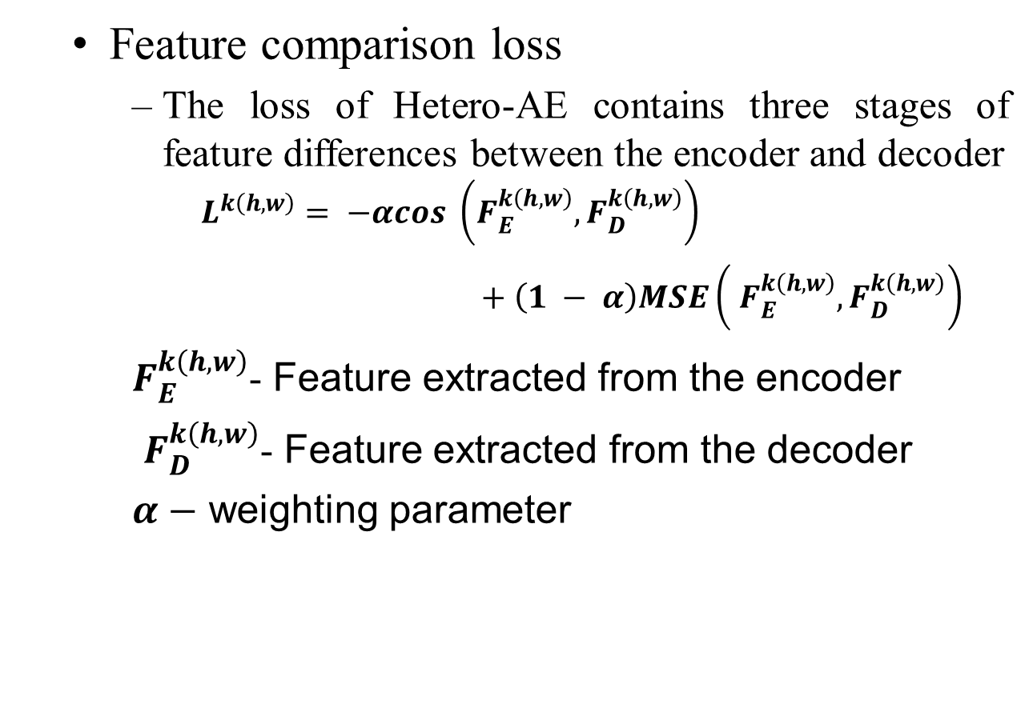
Loss and Anomaly Score
Feature comparison loss
The loss of Hetero-AE contains three stages of feature differences between the encoder and decoder
$$L^{k\left(h,w\right)}= −αcos \left.\left(F_{E}^{k\left(h,w\right)}, F_{D}^{k\left(h,w\right)}\right.\right)$$
$+ \left(1 − α\right)MSE\left.\left( F_{E}^{k\left(h,w\right)}, F_{D}^{k\left(h,w\right)}\right.\right)$
$F_{E}^{k\left(h,w\right)}$- Feature extracted from the encoder
$F_{D}^{k\left(h,w\right)}$- Feature extracted from the decoder
$α−$ weighting parameter

Slide 44
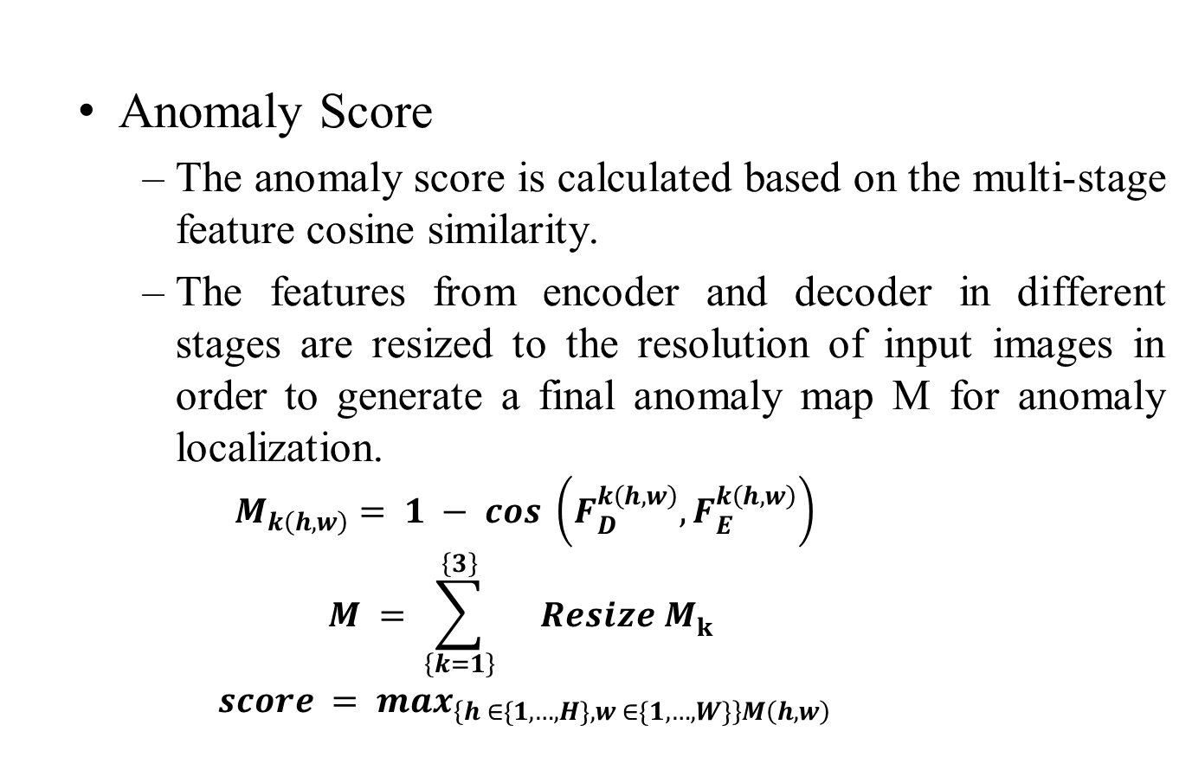
Loss and Anomaly Score
Anomaly Score
The anomaly score is calculated based on the multi-stage feature cosine similarity.
The features from encoder and decoder in different stages are resized to the resolution of input images in order to generate a final anomaly map M for anomaly localization.
$$M_{k\left(h,w\right)}= 1 − cos \left.\left(F_{D}^{k\left(h,w\right)}, F_{E}^{k\left(h,w\right)}\right.\right)$$
$$M = \sum_{\left\{k=1\right\}}^{\left\{3\right\}}{}Resize M_{k}^{}$$
$$score = max_{\left\{h ∈\{1, …, H\}, w ∈\{1, …, W\}\right\}M\left(h,w\right)}$$

Slide 45
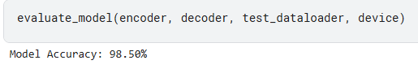
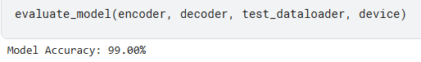
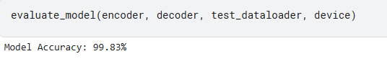
Result
For Xray
For Retinal
For MRI

Slide 46
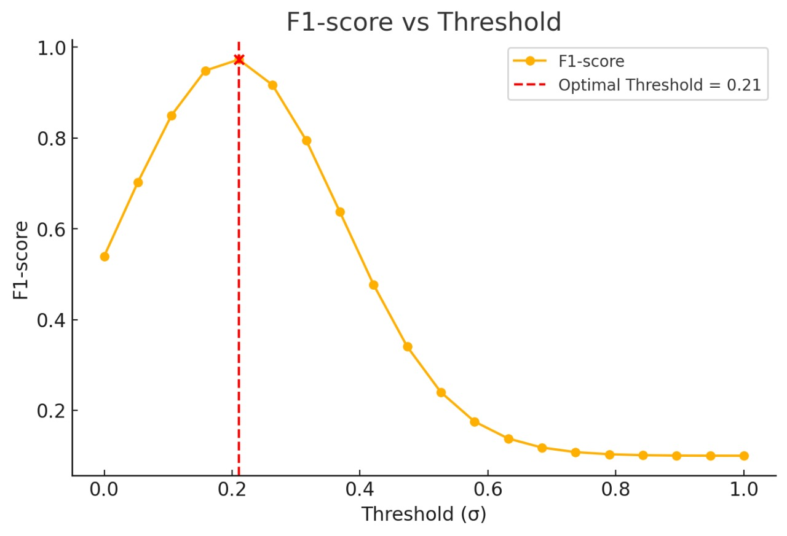

Slide 47
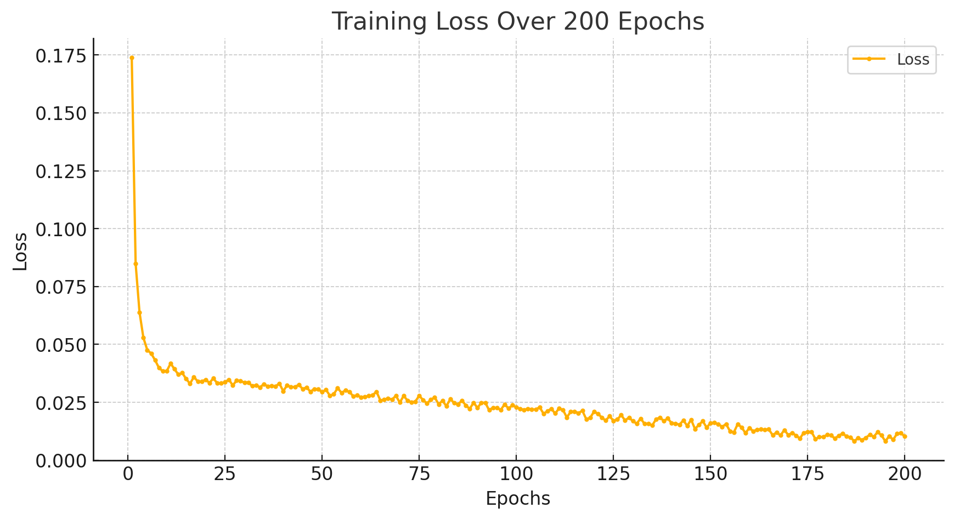
Training Loss for Brain MRI

Slide 48
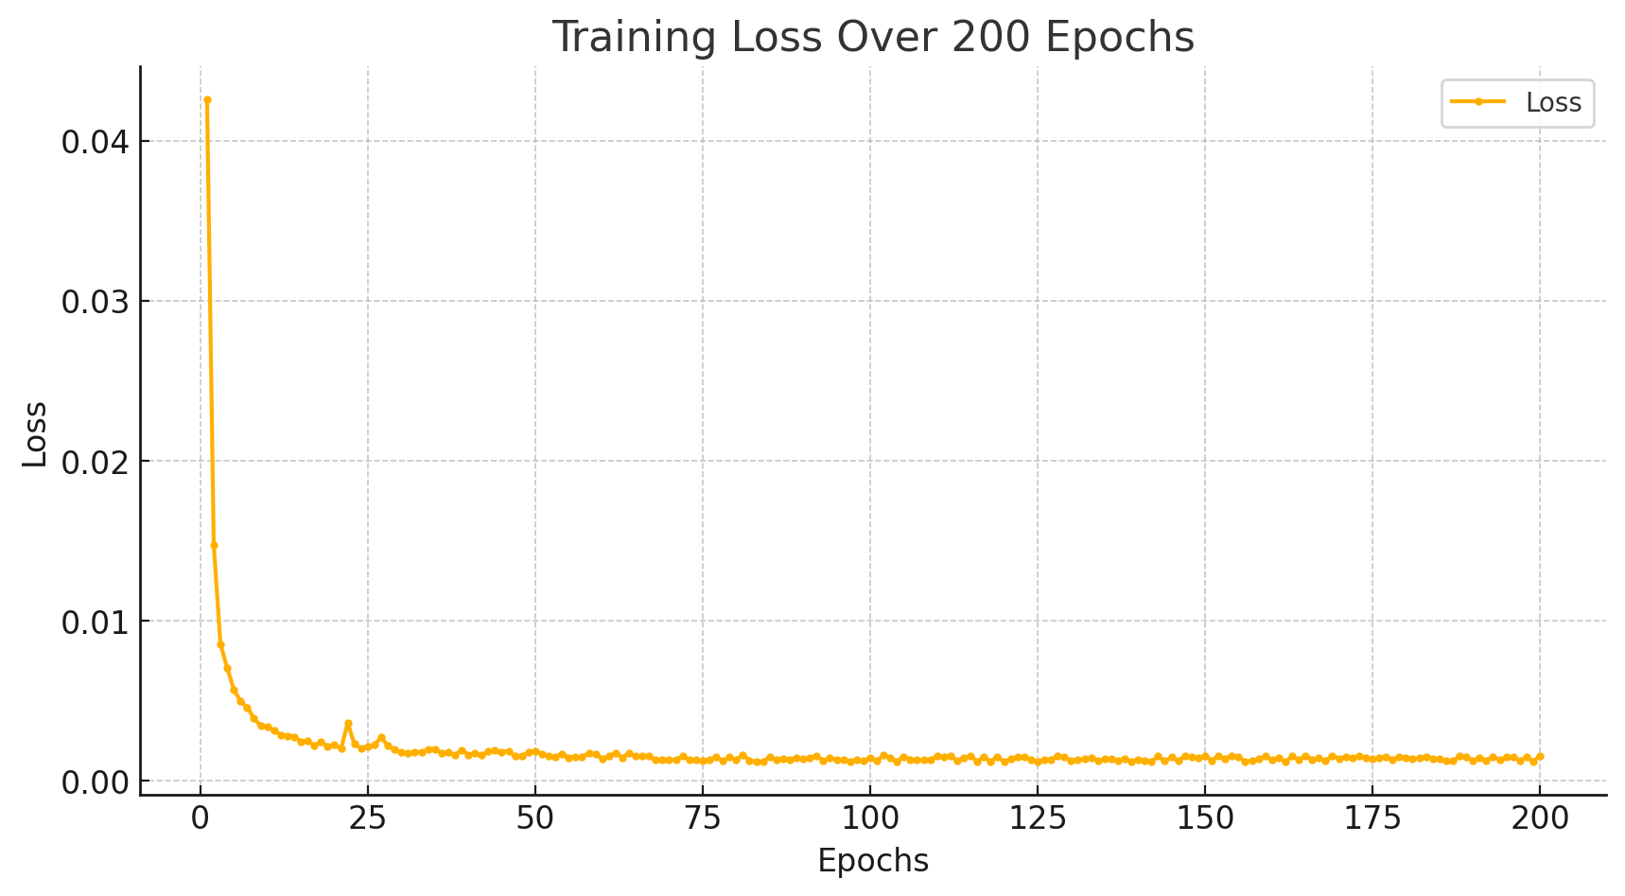
Training Loss for Retinal OCT

Slide 49
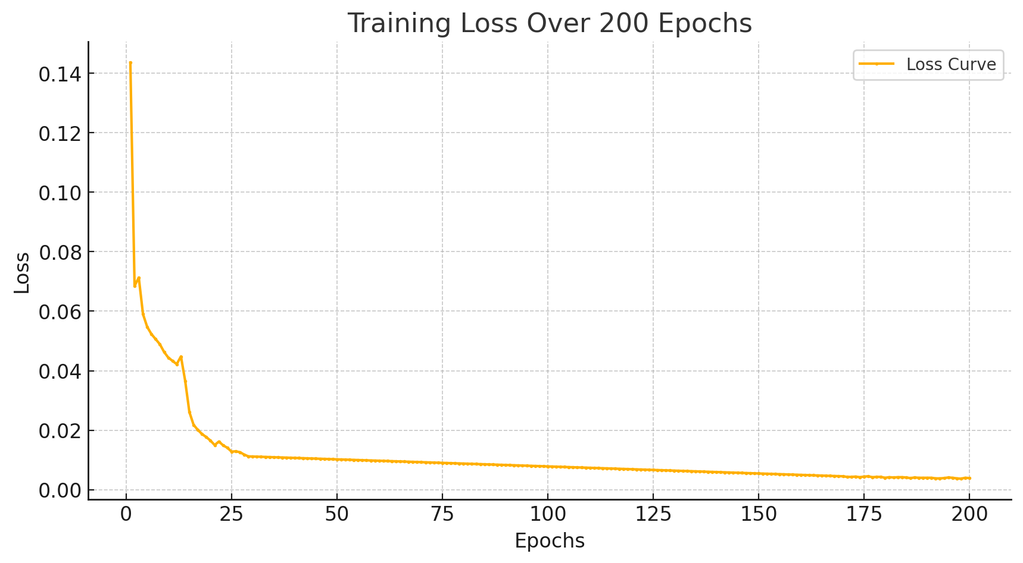
Training Loss for Chest Xray

Slide 50
Comparison across models
Model Name | Modality | ACC | AUC | F1-score | Recall | Precision
Resnet-50 | Brain MRI | 98.67 | 99 | 98 | 98 | 98
Ensemble(MobileNetV2, EfficientNet, InceptionNetV3, DenseNet) | Retinal OCT | 99.76 | N/A | 97.5 | 99.25 | 99.25
Encoder-Decoder Contrast | Brain MRI | 99.35 | 99.85 | 99.57 | N/A | N/A
AlexNet-SVM | Retinal OCT | 98.96 | N/A | 99 | N/A | N/A
VGG16 | Retinal OCT | 97 | N/A | N/A | N/A | N/A
DL-Net | Retinal OCT | 99.67 | N/A | N/A | N/A | N/A
VGG-16 | Retinal OCT, Chest XRAY | 90.35 | N/A | N/A | N/A | N/A
Self-interpretable network | Retinal OCT, Chest XRAY | 90.25 | N/A | N/A | N/A | N/A
Proposed Heterogeneous Autoencoder | Brain MRI, Retinal OCT, Chest X-RAY | 95.6 | 95 | 95 | 96 | 96.2

Slide 51
An Automated Chest X-Ray Image Analysis for Covid-19 and Pneumonia Diagnosis Using Deep Ensemble Strategy
Module-3
1. Proposed Approach:
Deep Ensemble Strategy: Combines three deep learning models (VGG-16, DenseNet-201, EfficientNet-B0) using transfer learning to enhance classification accuracy.
Pre-processing: Image resizing, normalization, and data augmentation (zoom, rotation, flipping) to improve model performance.
Feature Extraction: Uses pre-trained models to extract features from X-ray images.

Slide 52
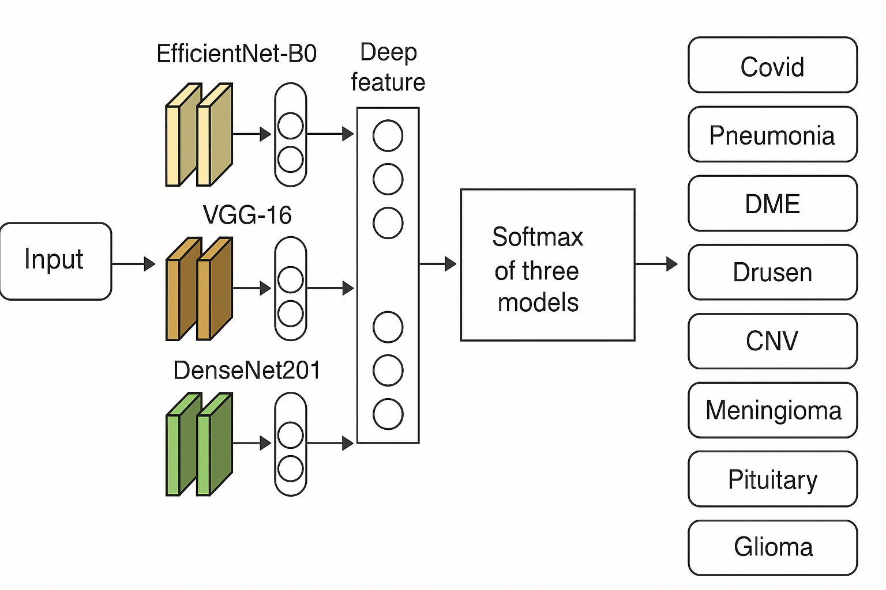

Slide 53
Result
The ensemble of VGG-16, DenseNet-201, and EfficientNet-B0 leads to 98% accuracy, making it a powerful tool for the anomaly classification.

Slide 54
Datasets | MobileNet (ACC) | Resnet-50 (ACC) | Ensemble Method (ACC)
Brain MRI | 0.88 | 0.99 | 97
Chest Xray | 0.90 | 0.92 | 98
Retinal OCT | 0.99 | 0.95 | 95

Slide 55
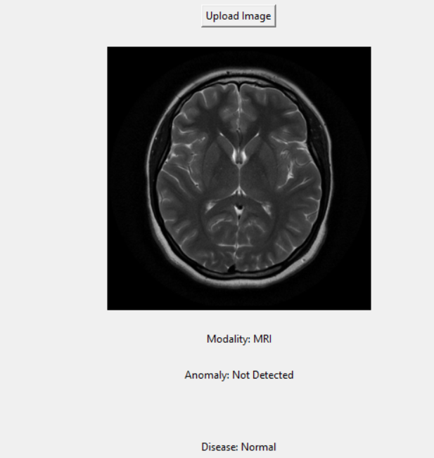
Output

Slide 56
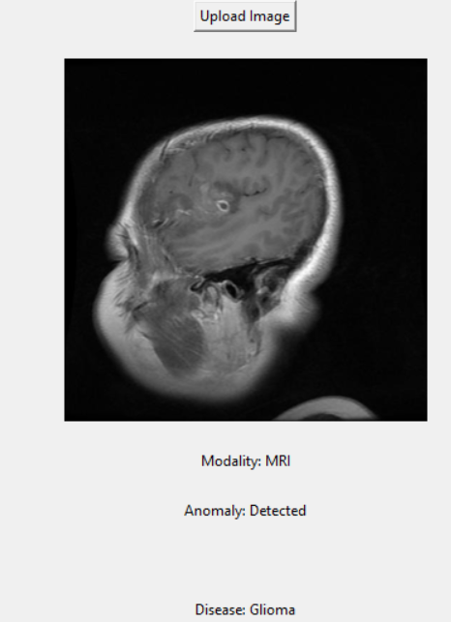

Slide 57
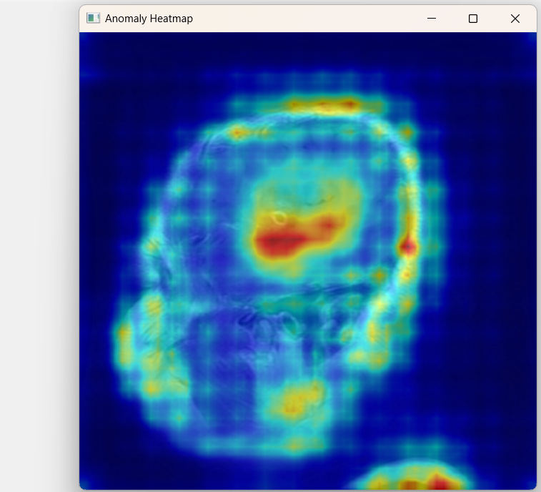
Heatmap

Slide 58
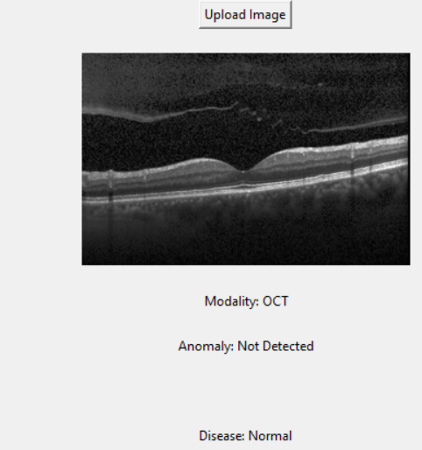

Slide 59
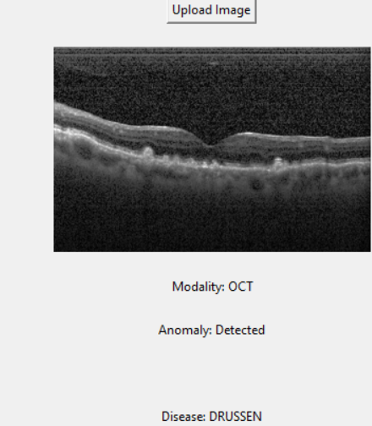

Slide 60
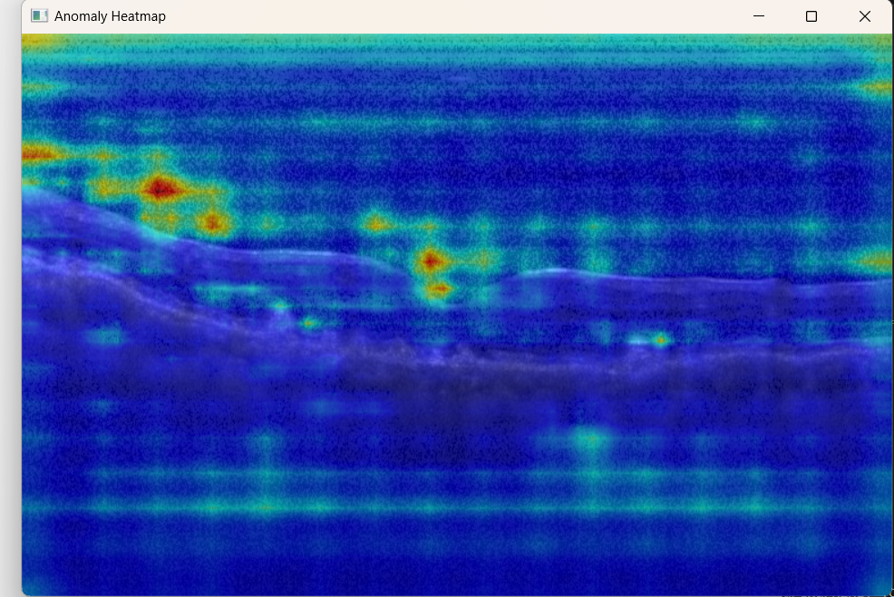

Slide 61
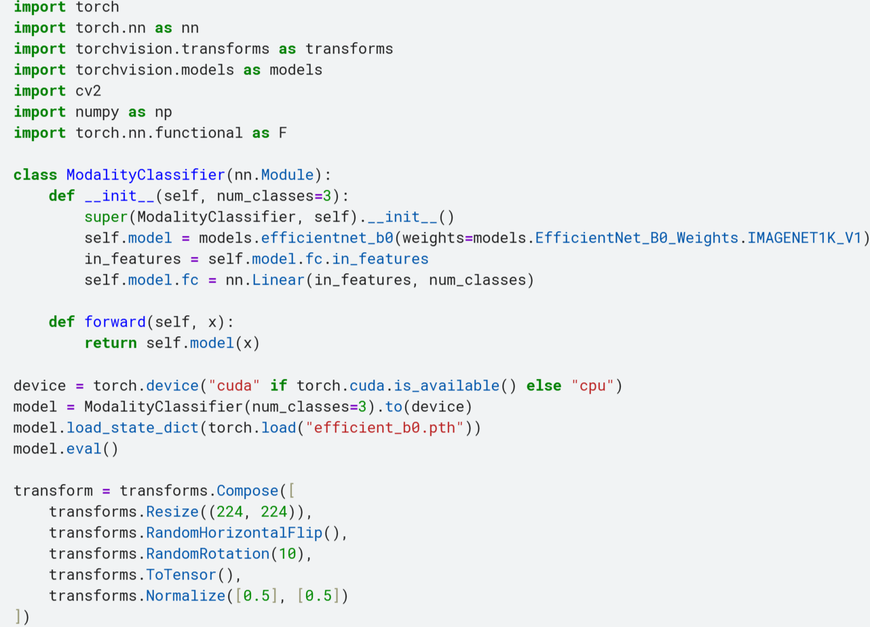
Implementation

Slide 62
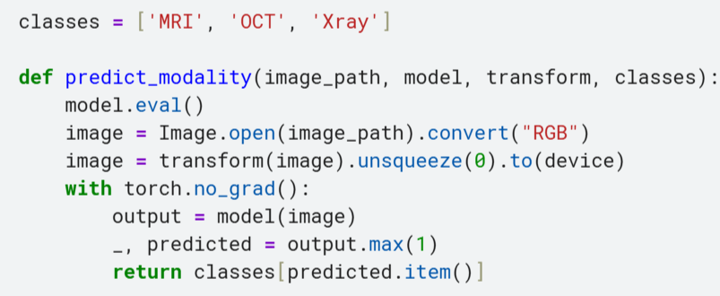

Slide 63
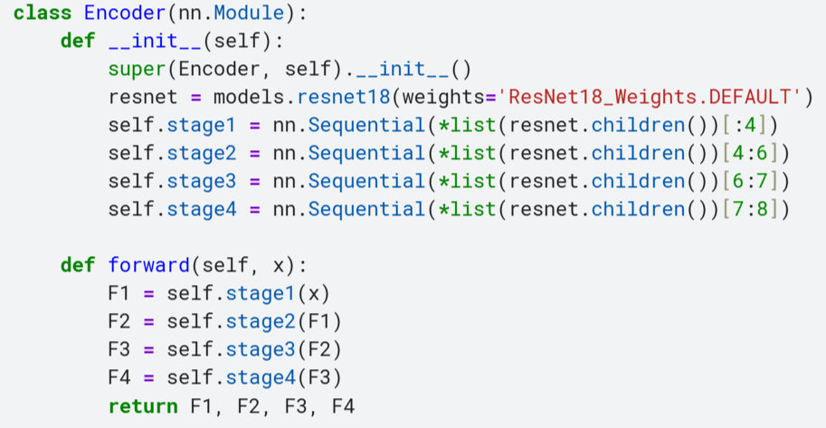

Slide 64
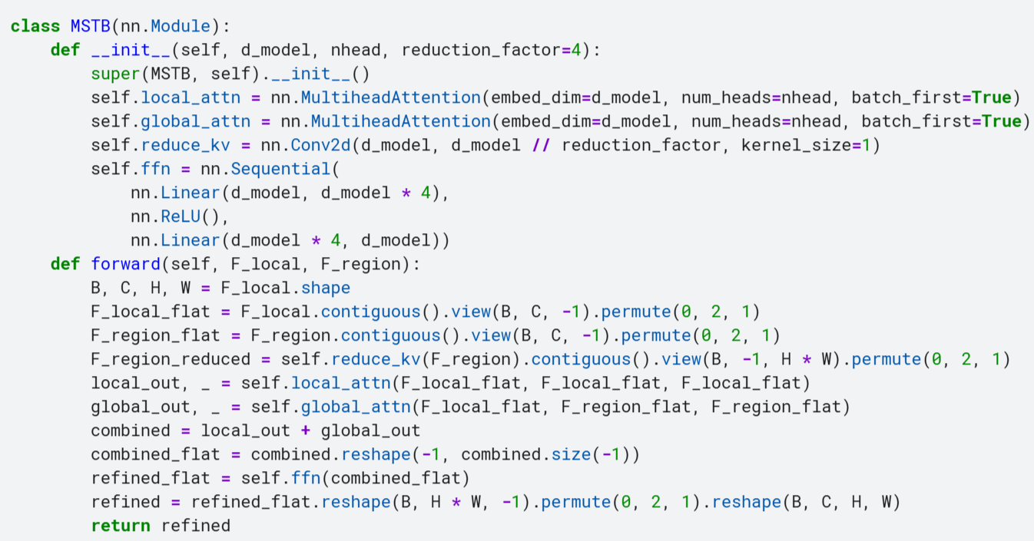

Slide 65
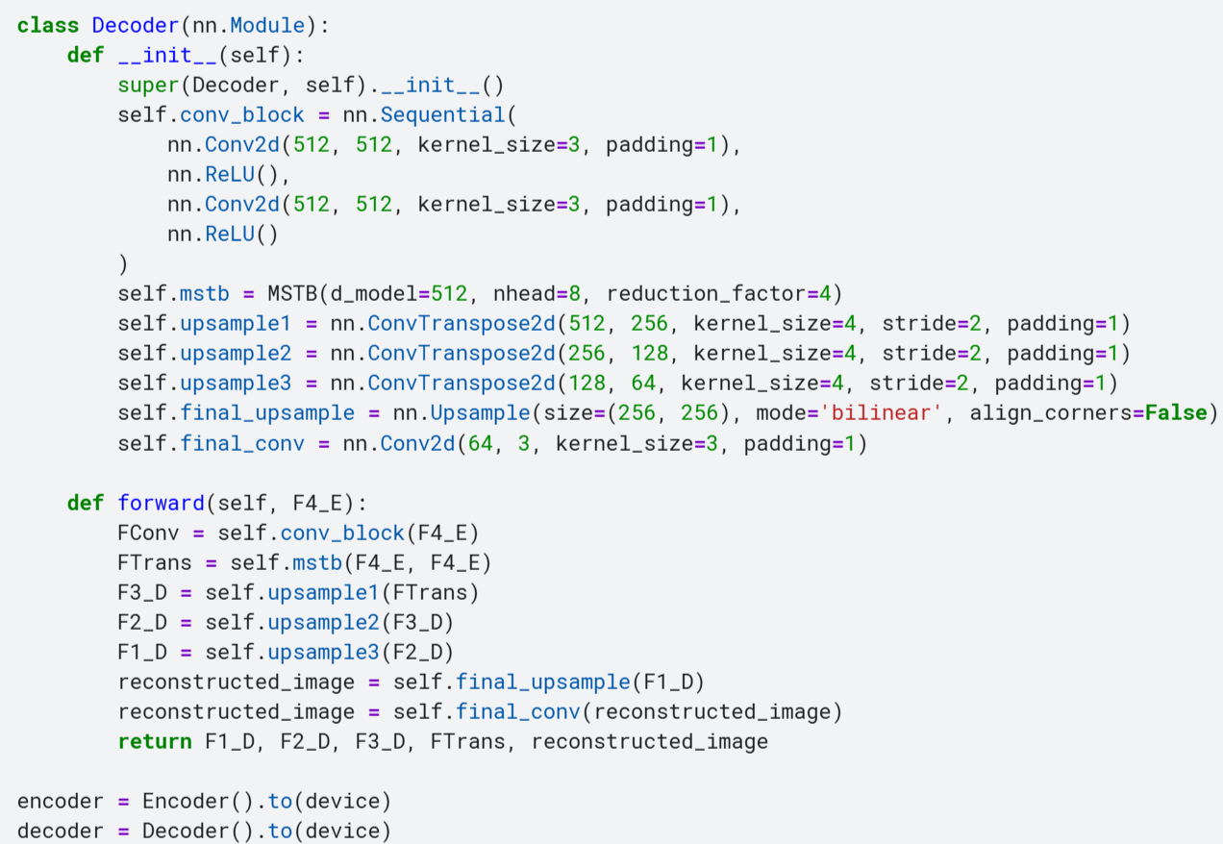

Slide 66
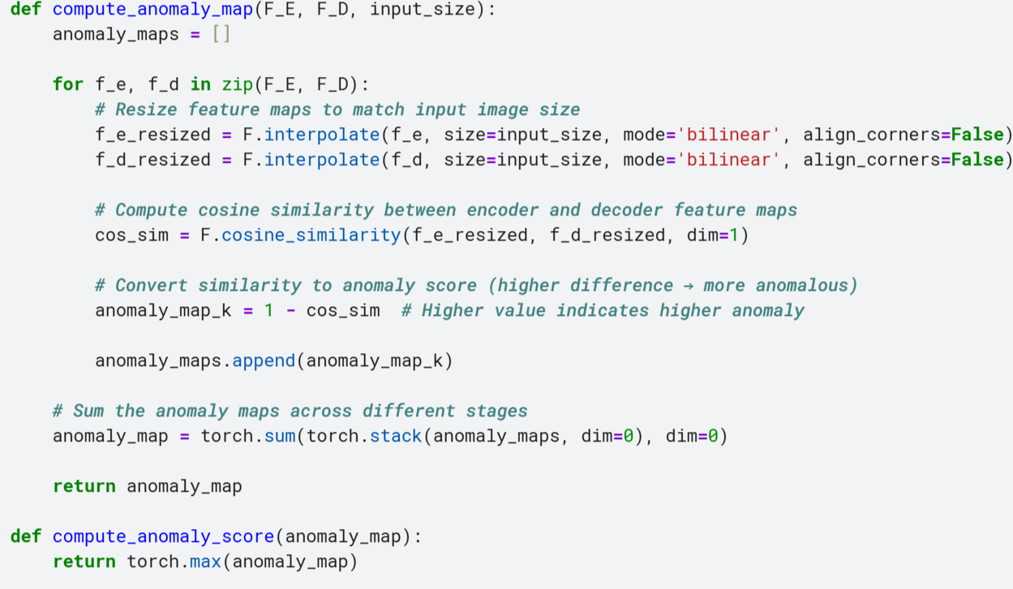

Slide 67
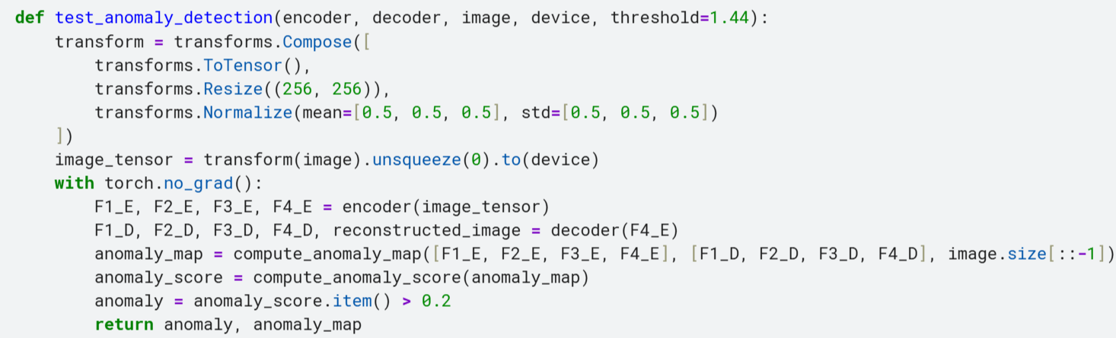

Slide 68
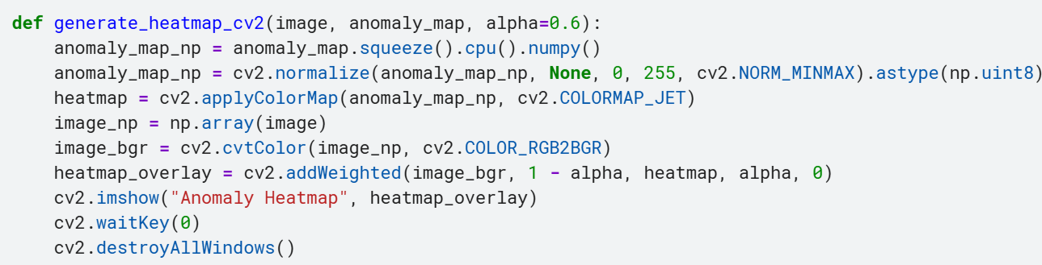

Slide 69
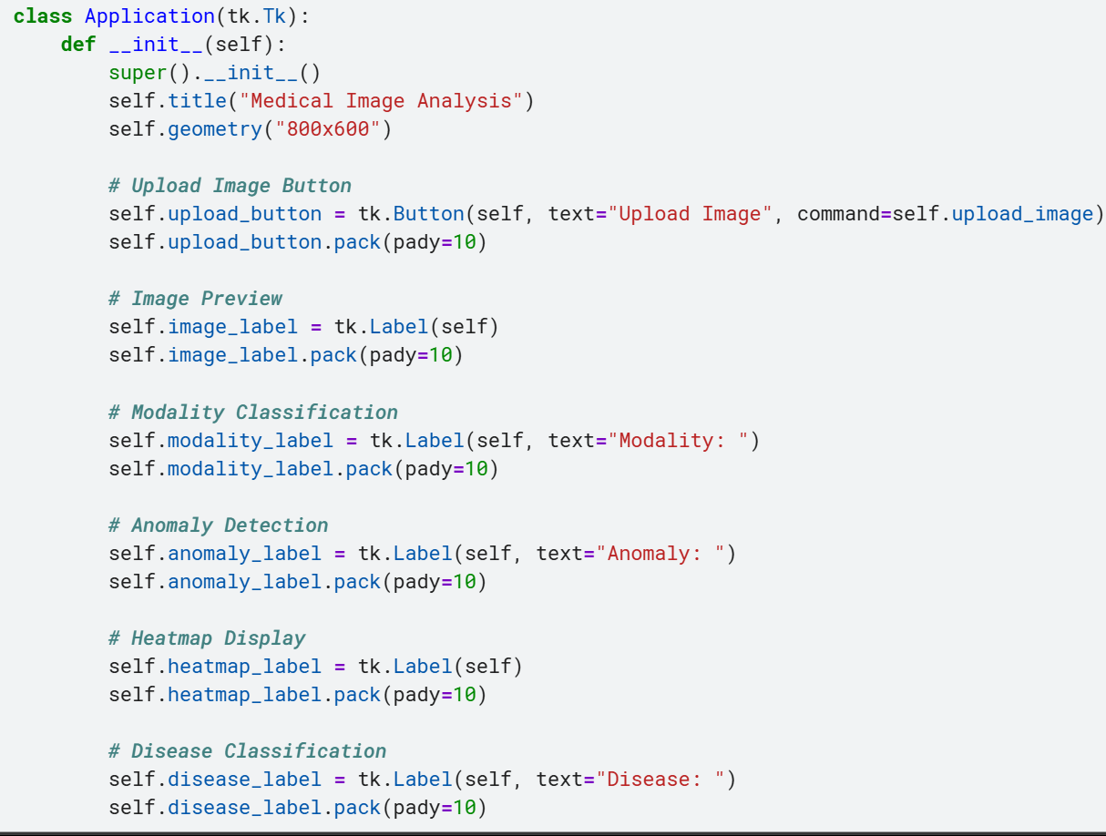

Slide 70
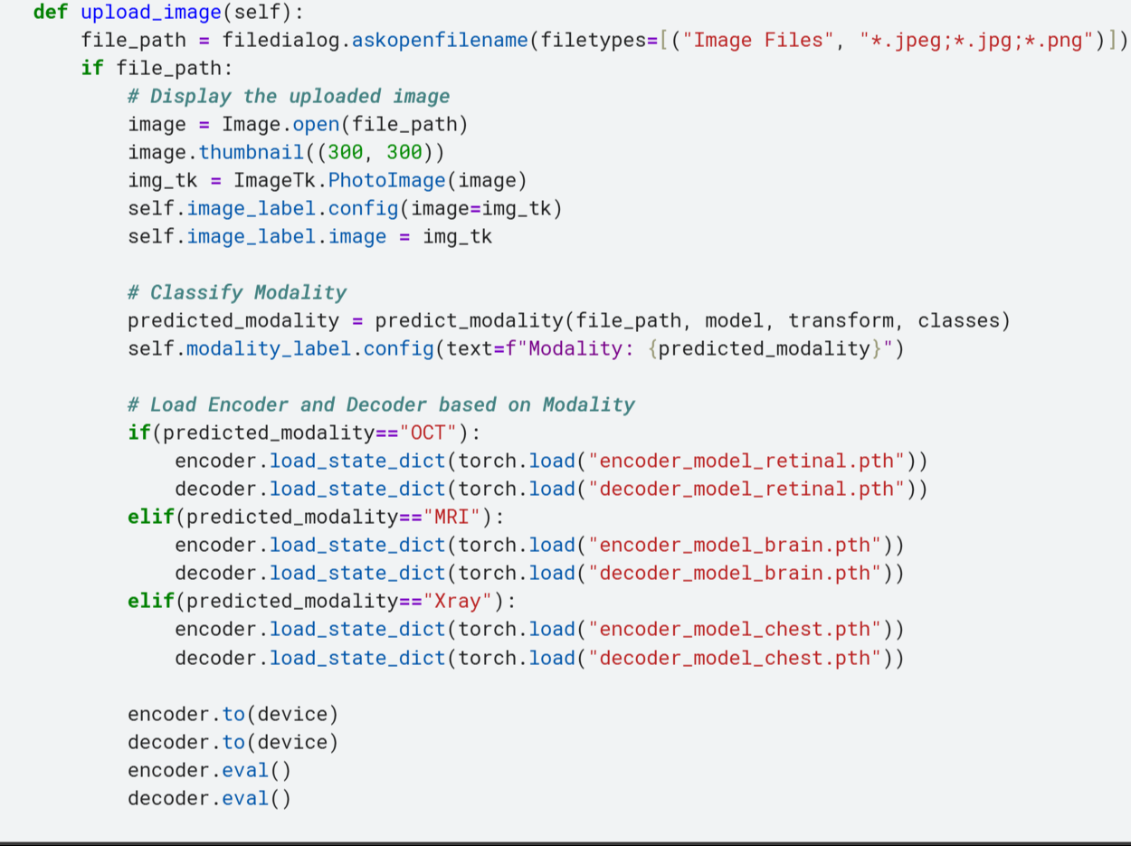

Slide 71
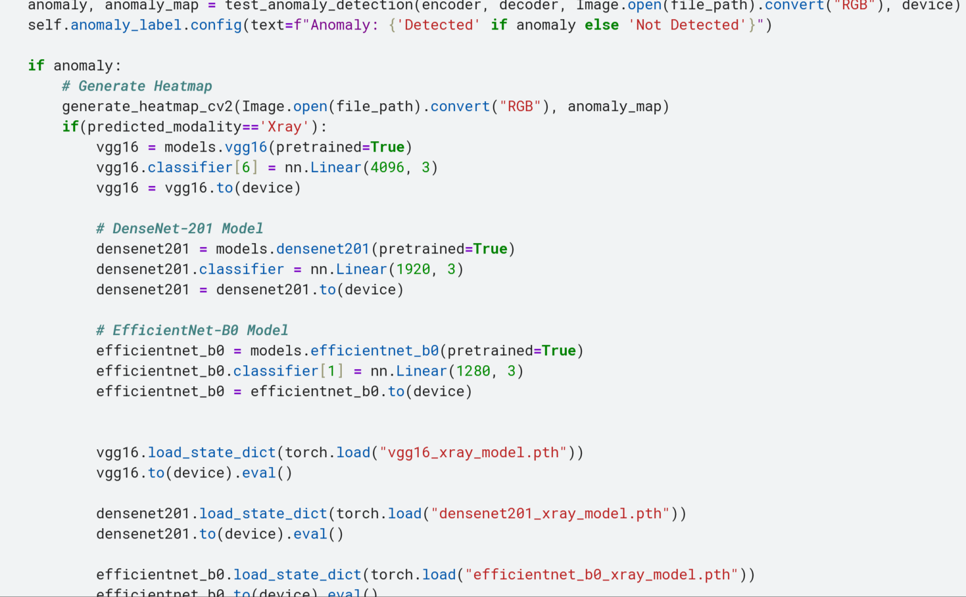

Slide 72
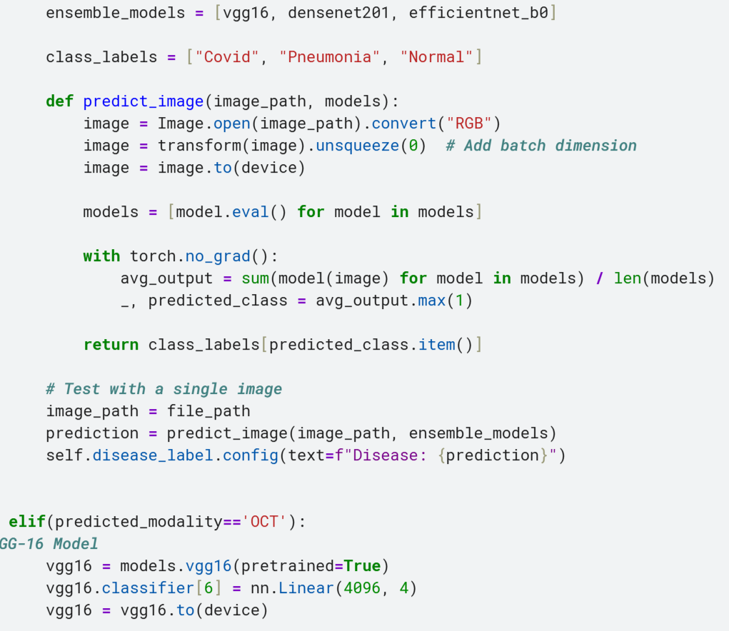

Slide 73
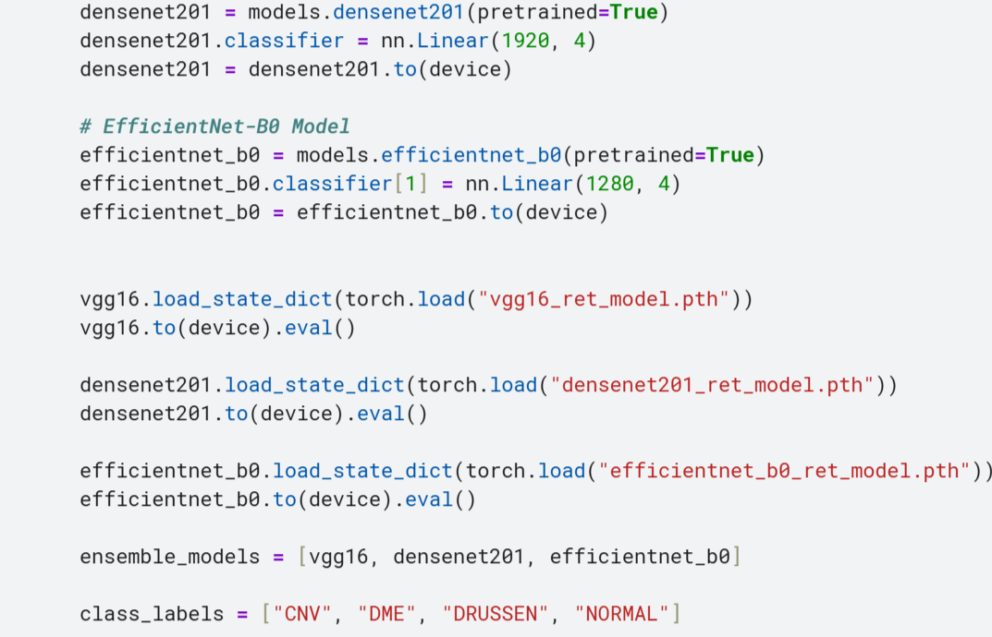

Slide 74
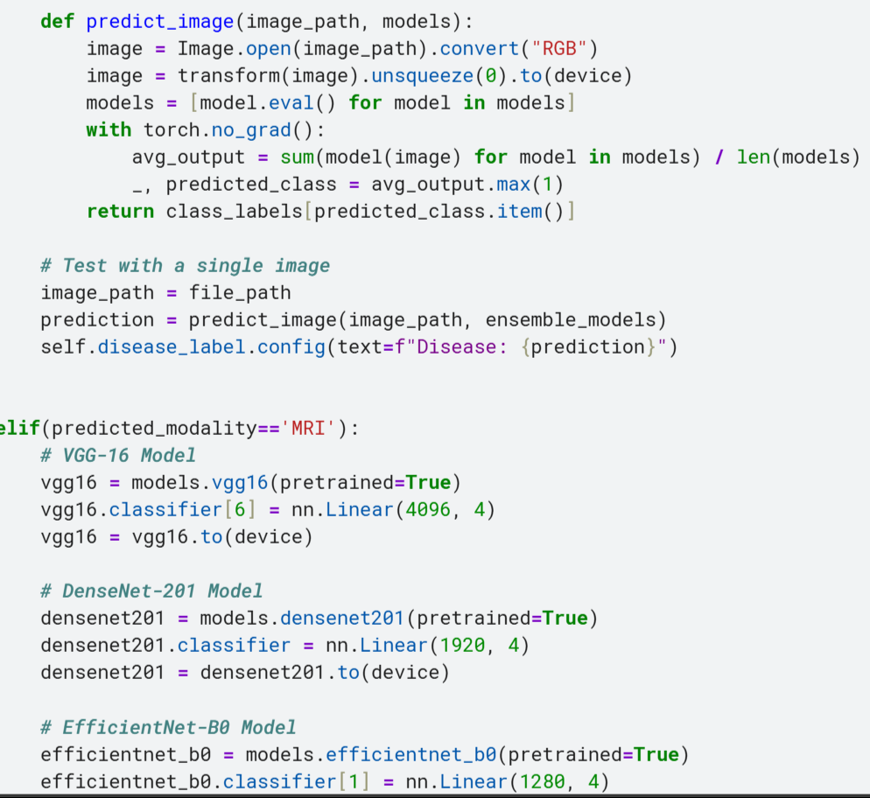

Slide 75
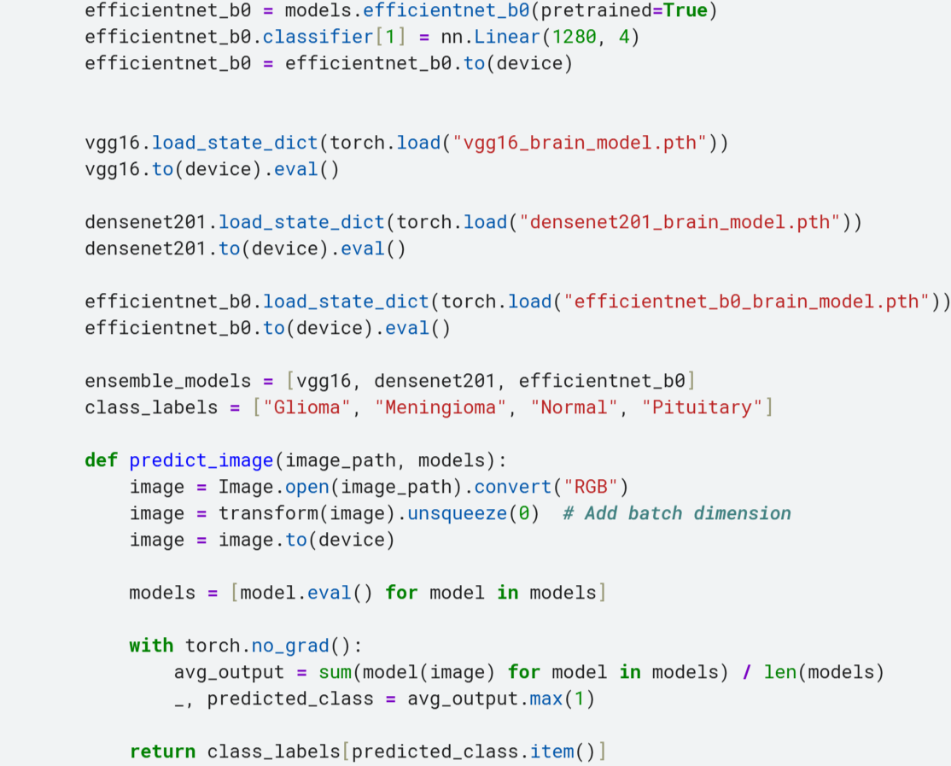

Slide 76
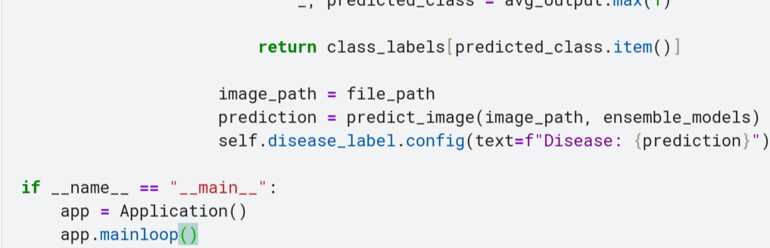

Slide 77
Social Impact
Improved Healthcare Outcomes
Increased Access to Healthcare
Empowerment of Healthcare Professionals
Patient Trust and Engagement
Research and Innovation

Slide 78


Publication

Slide 79


Slide 80
References
Lu, Shuai, Zhang, Weihang, Zhao, He, Liu, Hanruo, Wang, Ningli, and Li, Huiqi, “Anomaly Detection for Medical Images Using Heterogeneous Auto-Encoder,” IEEE Transactions on Image Processing, 2024, Volume 33, Issue 4, Pages 2770-2782, DOI: 10.1109/TIP.2024.3381435.

Slide 81
References
Hussain, Adnan, Amin, Sareer Ul, Lee, Hunjoo, Khan, Asma, Khan, Noreen Fayyaz, and Seo, Sanghyun, “An Automated Chest X-Ray Image Analysis for Covid-19 and Pneumonia Diagnosis Using Deep Ensemble Strategy,” IEEE Access, 2023, Volume 11, Pages 97207-97220, DOI: 10.1109/ACCESS.2023.3312533.

Slide 82
Thank You

